Slide 2
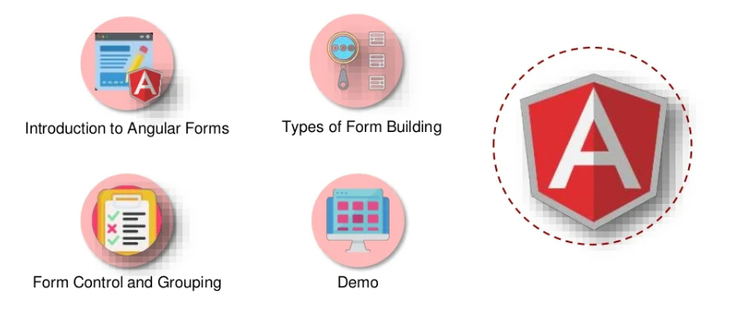
Angular Forms

Slide 3
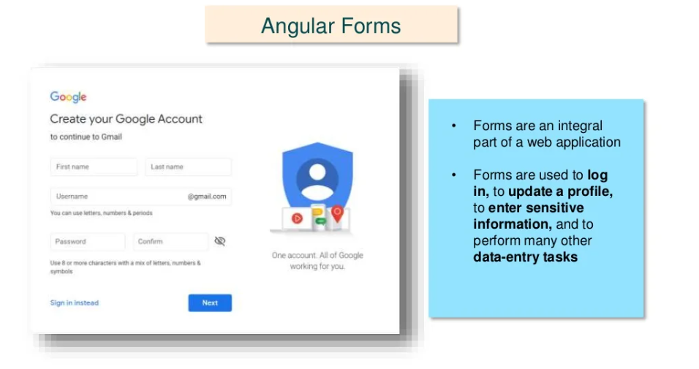

Slide 4


Types of Form Building

Slide 5
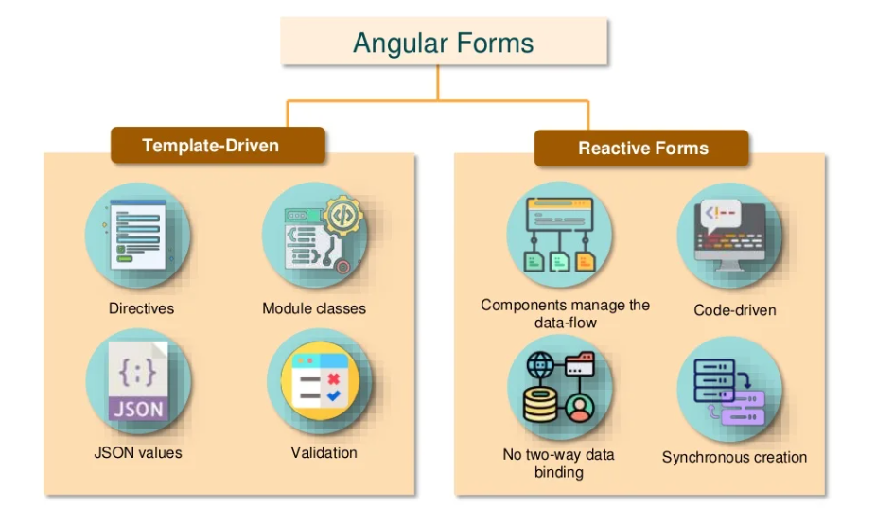

Slide 6
Form Control and Form Group

Slide 7
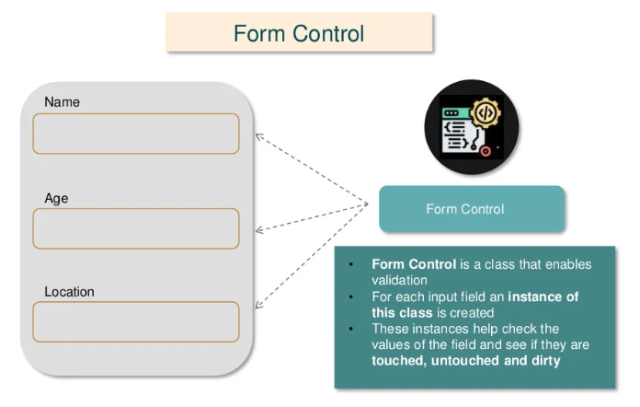

Slide 8
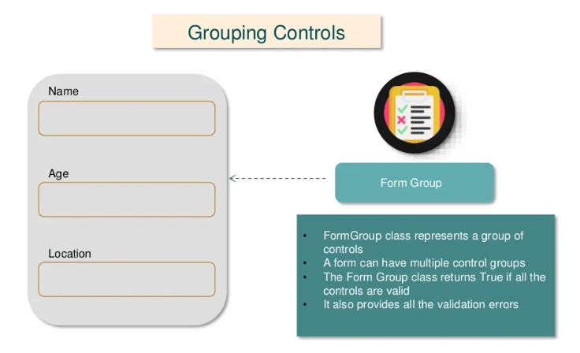

Slide 9
Demo

Slide 10


